Slide 1
KROWN Awards FCA Account
June 2020
KPIT

Slide 2


Dear Amit Suryawanshi,
We are pleased to present the Go-Getter Award to you for your exemplary efforts for UDD project. Thank you for all your contributions for making the project steady!
Congratulations! Keep It Up!!!
June 2020
Authorized Signatory

Slide 3
Dear Sayali Nemade,
We are pleased to present the Go-Getter Award to you for your outstanding efforts for UDD project. Your diligent & timely efforts are certainly to be appreciated!!
Congratulations! Keep It Up!!!
June 2020
Authorized Signatory

Slide 4
Dear Swanand Mehta,
We are pleased to present the Go-Getter Award to you for your determined efforts for UDD project. You are certainly an asset to the team!!
Congratulations! Keep It Up!!!
June 2020
Authorized Signatory

Slide 5
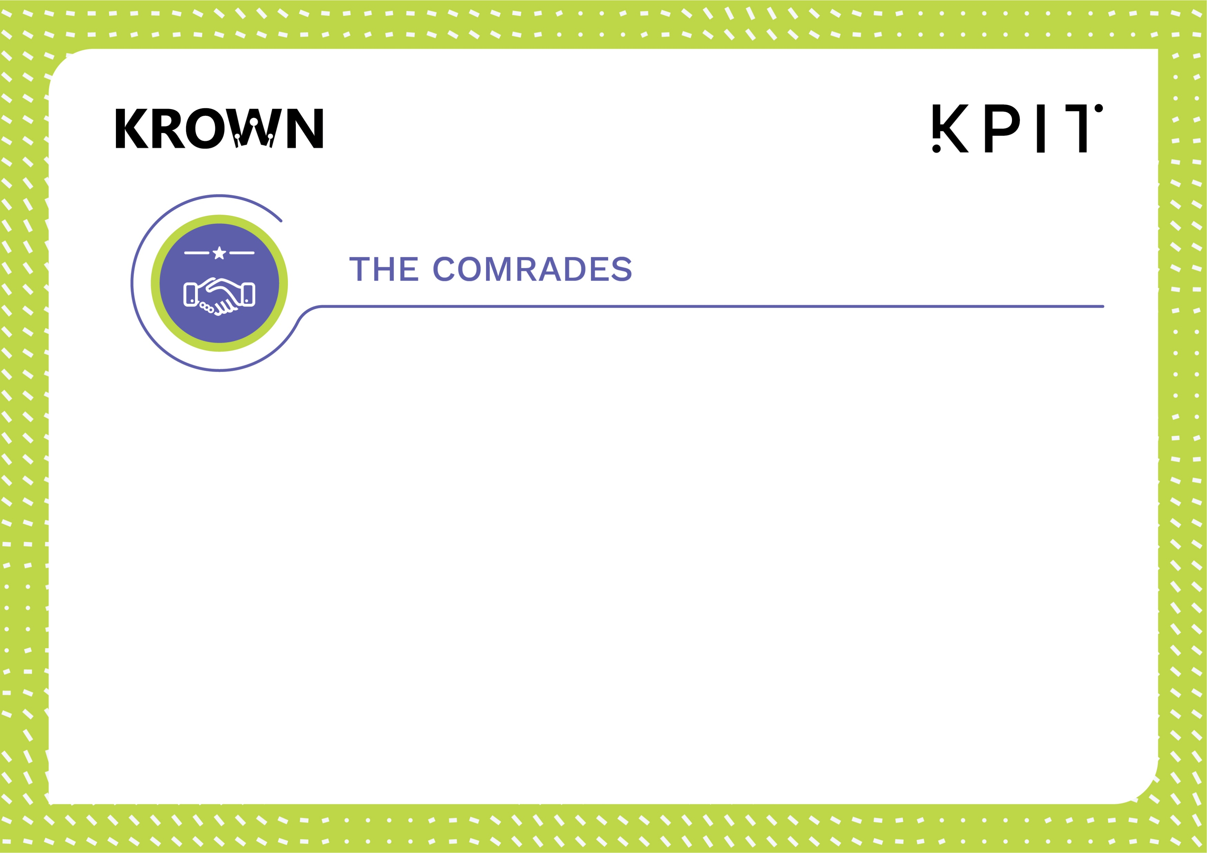
Dear Mrunal Kulkarni,
We are pleased to present the Comrades Award to you for your excellent efforts for successful BMS production roll out in Mar-2020!
Congratulations! Keep It Up!!!
June 2020
Authorized Signatory

Slide 6
Dear Omkar Badave,
We are pleased to present the Comrades Award to you for your excellent efforts for successful BMS production roll out in Mar-2020!
Congratulations! Keep It Up!!!
June 2020
Authorized Signatory

Slide 7
Dear Siddharth Patel,
We are pleased to present the Comrades Award to you for your excellent efforts for successful BMS production roll out in Mar-2020!
Congratulations! Keep It Up!!!
June 2020
Authorized Signatory

Slide 8
Dear Priyanka Pawar,
We are pleased to present the Comrades Award to you for your excellent efforts for successful BMS production roll out in Mar-2020!
Congratulations! Keep It Up!!!
June 2020
Authorized Signatory

Slide 9
Dear Sayali Nemade,
We are pleased to present the Comrades Award to you for your excellent efforts for successful BMS production roll out in Mar-2020!
Congratulations! Keep It Up!!!
June 2020
Authorized Signatory

Slide 10
Dear Rupchand Kale,
We are pleased to present the Comrades Award to you for your excellent efforts for successful BMS production roll out in Mar-2020!
Congratulations! Keep It Up!!!
June 2020
Authorized Signatory

Slide 11
Dear Akshay Rale,
We are pleased to present the Comrades Award to you for your excellent efforts for successful BMS production roll out in Mar-2020!
Congratulations! Keep It Up!!!
June 2020
Authorized Signatory

Slide 12
Dear Swanand Mehta,
We are pleased to present the Comrades Award to you for your excellent efforts for successful BMS production roll out in Mar-2020!
Congratulations! Keep It Up!!!
June 2020
Authorized Signatory

Slide 13
Dear Amit Suryawanshi,
We are pleased to present the Comrades Award to you for your excellent efforts for successful BMS production roll out in Mar-2020!
Congratulations! Keep It Up!!!
June 2020
Authorized Signatory

Slide 14
Dear Rohit Bhosale,
We are pleased to present the Comrades Award to you for your excellent efforts for successful BMS production roll out in Mar-2020!
Congratulations! Keep It Up!!!
June 2020
Authorized Signatory

Slide 15
Dear Swapnali Jadhav,
We are pleased to present the Comrades Award to you for your excellent efforts for successful BMS production roll out in Mar-2020!
Congratulations! Keep It Up!!!
June 2020
Authorized Signatory

Slide 16
Dear MD Hasan,
We are pleased to present the Comrades Award to you for your excellent efforts for successful BMS production roll out in Mar-2020!
Congratulations! Keep It Up!!!
June 2020
Authorized Signatory

